Slide 2
A “Reassuring Christmas”…
1) CHRISTMAS PROMISED
“fulfilled” (v1)
2) CHRISTMAS PRESENT
“eyewitness” (v2)

Slide 3
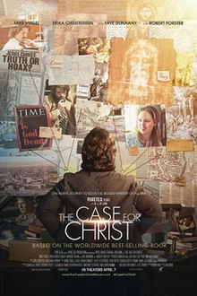
Film:
“The Case for Christ” (2017)
Lee Strobel

Slide 4
A “Reassuring Christmas”…
1) CHRISTMAS PROMISED
“fulfilled” (v1)
2) CHRISTMAS PRESENT
“eyewitness” (v2)

