Slide 1
A “Reassuring Christmas”…
1) CHRISTMAS PROMISED
Mary’s Song (Luke 1:46-56)

Slide 2
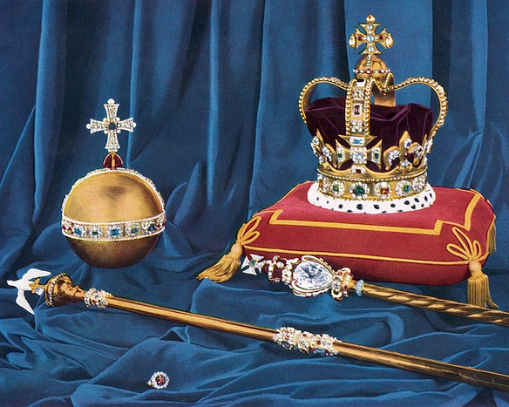

Slide 3
A “Reassuring Christmas”…
Location
Micah 5:2
700+ BC
Isaiah 7:14 & 9:2
Nature
700+ BC
Purpose
Genesis 3:15
1500+ BC
Lineage
See Luke 3 family tree
Adam
Abraham
Judah
David
See https://www.jesusfilm.org/blog/old-testament-prophecies/

Slide 4
A “Reassuring Christmas”…
1) CHRISTMAS PROMISED
Mary’s Song (Luke 1:46-56)

