Slide 1
The LORD Reigns (Psalm 99)

Slide 2
The LORD Reigns (Psalm 99)
1) This is a Psalm!
2) This is a little known Psalm!
3) This is a “Book 4” Psalm!
4) This is “3 or 4 way” Psalm!
2
5) This is an encouraging Psalm!

Slide 3
The LORD Reigns (Psalm 99)
1) (v1-5)
He is GREAT!
Specific
2) (v6-9)

Slide 4
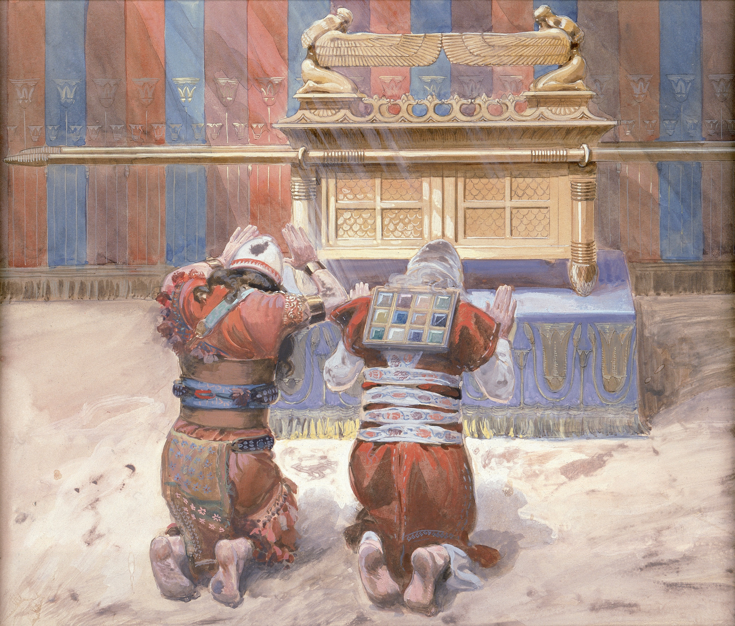

Slide 5
The LORD Reigns (Psalm 99)
1) (v1-5)
He is GREAT!
Specific
Global
Holy
2) (v6-9)

Slide 7
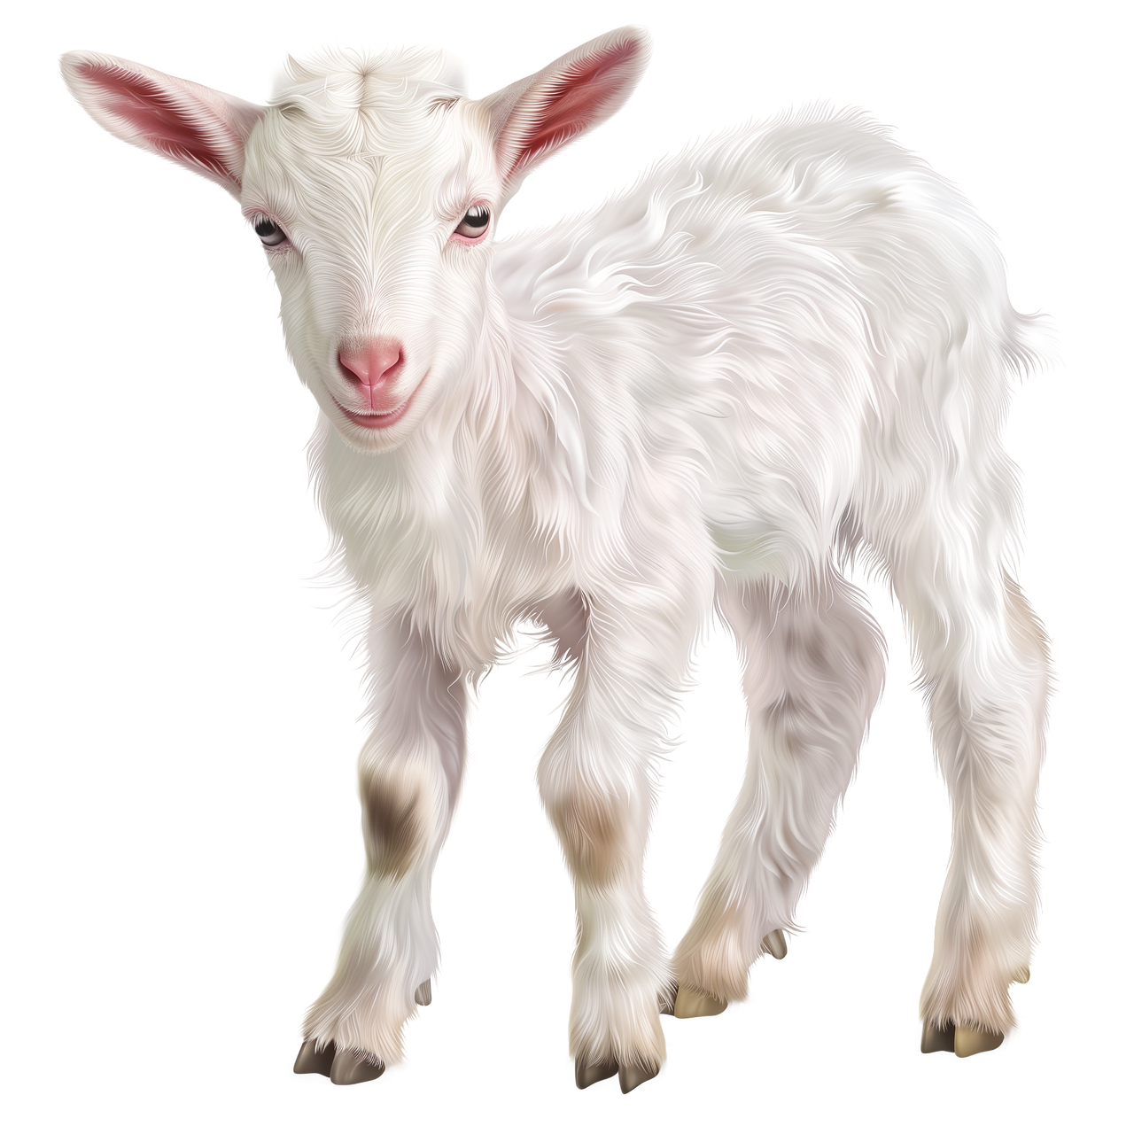
The LORD Reigns (Psalm 99)
He is GREAT!
1) (v1-5)
Specific
Global
Holy
➔ Outsiders take note!
He is GRACIOUS!
2) (v6-9)
Answering prayer
merciful
➔ Insiders take note!

