Slide 1
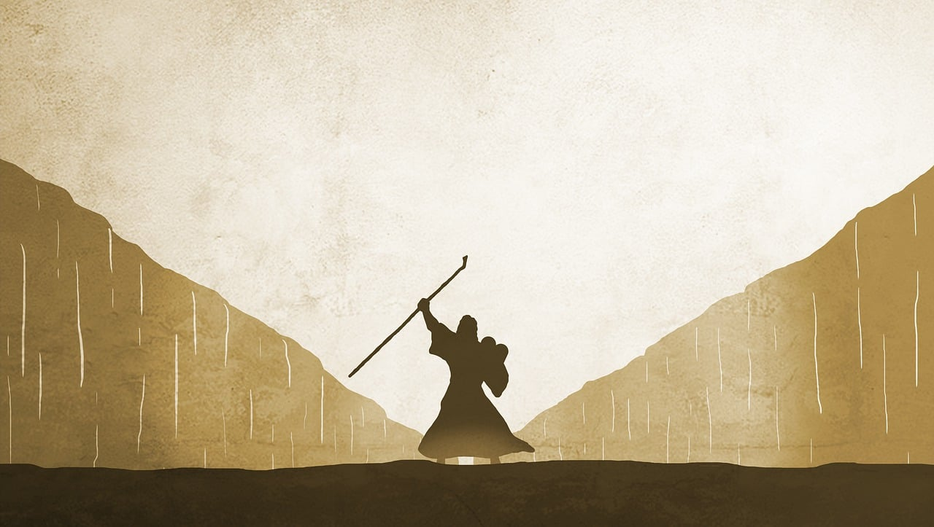
GREAT BIG GOD!
Part 4: The God who substitutes. Exodus 12

Slide 2
The LORD said, “I have indeed seen the misery of my people in Egypt” Exodus 3v7 NIV

Slide 3
The LORD said to Moses and Aaron in Egypt, “This month is to be for you the first month, the first month of your year.” Exodus 12v1-2 NIV

Slide 4
TRUST and OBEY

