Slide 1
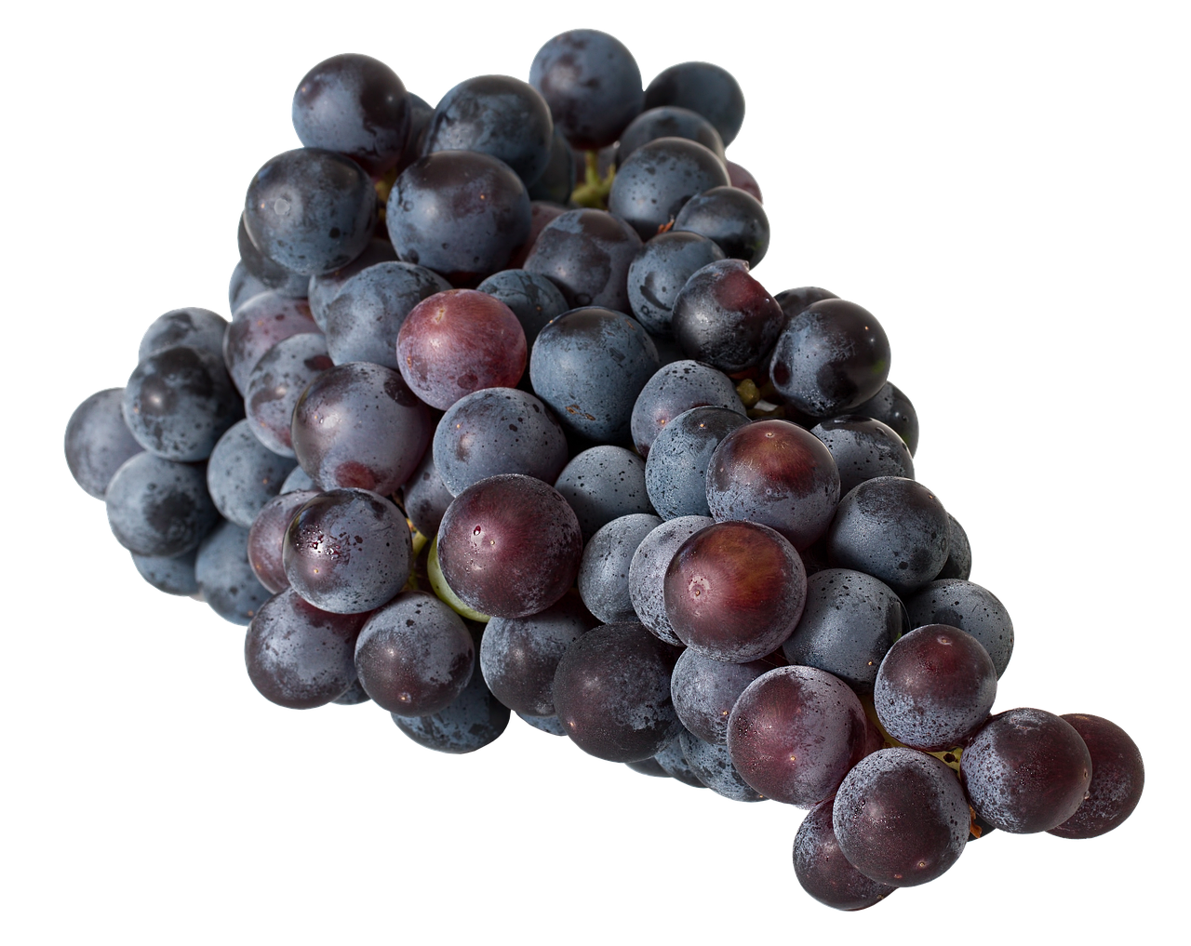
John 15: the total importance of Jesus
1)
2)
More fruit with Jesus’ pruning!
No fruit without Jesus!
V1-2a
V2b-3
Summary:
Stick with Jesus!
V4
pleasing!
useful!

