Slide 1
“WHAT DID I TELL YOU?!”
Scene 1
confused!
(v13-24)
(v25-31)
Scene 2
(OF THE BIBLE)
CHRIST
Scene 3
CHEERFUL!
(v32-35)
Page 1061
EASTER 2024

Slide 2
“What did I tell you?!”
EASTER 2024

Slide 3
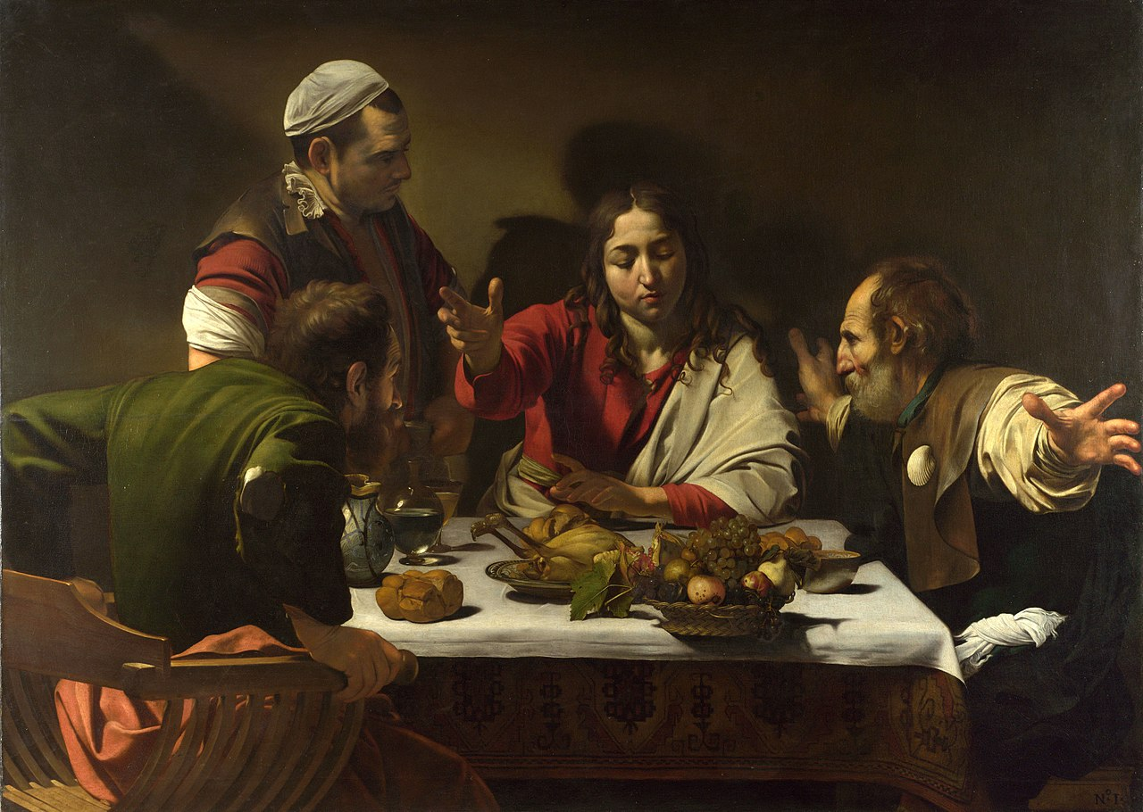
“WHAT DID I TELL YOU?!”
Scene 1
confused!
(v13-24)
(v25-31)
Scene 2
(OF THE BIBLE)
CHRIST
Scene 3
CHEERFUL!
(v32-35)
EASTER 2024

Slide 4
“WHAT DID I TELL YOU?!”
Scene 1
confused!
(v13-24)
(v25-31)
Scene 2
(OF THE BIBLE)
CHRIST
Scene 3
CHEERFUL!
(v32-35)
EASTER 2024

