Slide 1
Church Family News
Today:
Weekend away next weekend! Laura will be in the foyer after the service with a card reader to pay for the weekend away. Day visitors still welcome! Talk to Laura Carter if you’d like to sign up.
No service at SMPS on Sunday 12th May.

Slide 2
Church Family News
Today:
The Carpenter’s Arms: Sunday 5th May, 3pm, The Coneygear Centre

Slide 3
Church Family News
This week:
Church Prayer Meeting: Wednesday 8th May, 7:30pm, St Mary’s Parish Hall

Slide 4
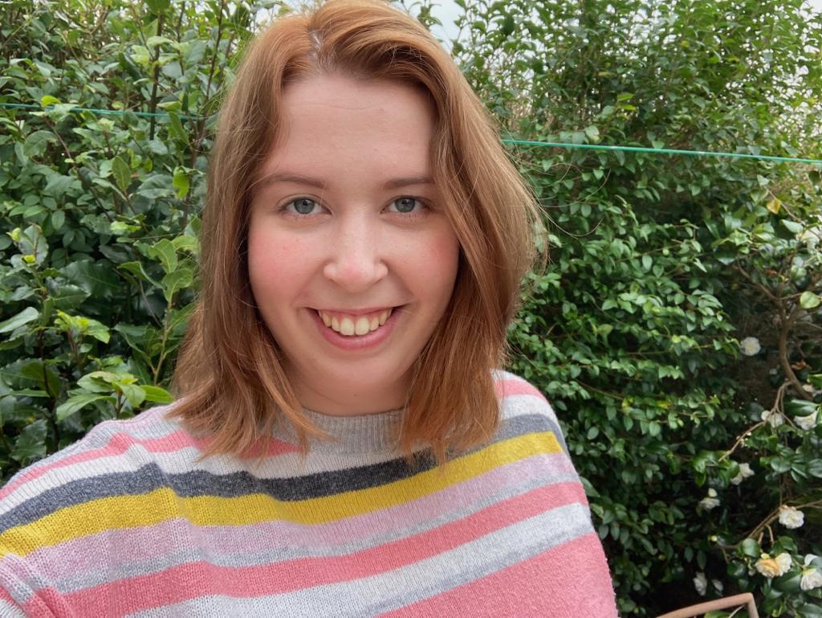
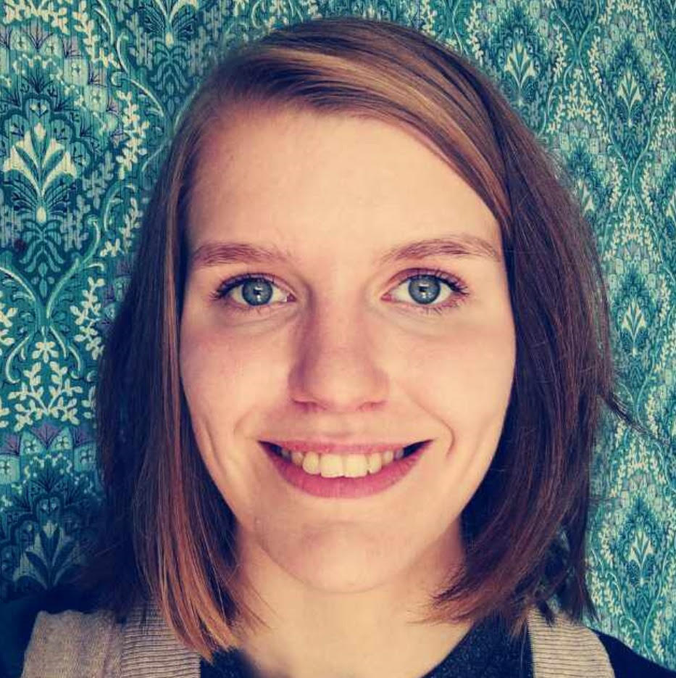
Beth
(Youth and Families Minister)
Susan
(Safeguarding Officer)
Children’s & Youth
Groups:
Creche – (0-2s) In the Music Room, with parents | Sparklers – (2-4s) In the Community Room with Jean, Cristina and Laura
GSMA - (Reception–Yr2) In the Staff Room with Jo and Emma | TROGs – (Yr3-Yr6) In the Hub Room with Bethany and Liz
CCHY (Yrs 7-13) – Dan and Laura’s house, 7-8:30pm With Beth, Emily, Dan and Laura

