Slide 1
CHRISTMAS

Slide 2
Acum, mi se pare că oamenii sunt mai interesaţi de lucrurile materiale, de cadouri, magazine, iar crâciunul s-a transformat întro sarbatoare în care primeşti sau cumpări multe lucrui de care nu ai nevoie, şi pe care, probabil, nu le vei folosit

Slide 3
Why bother with Christmas?

Slide 4
Why bother with Christmas?
Luke 1v26-38
God’s Promised King v26-33

Slide 5
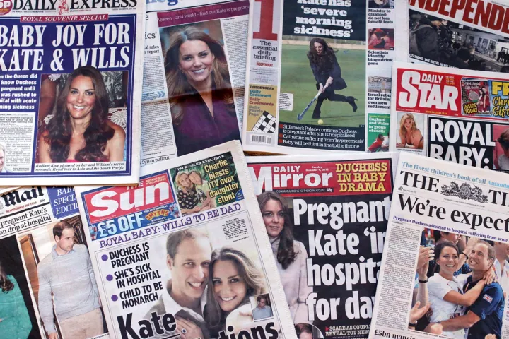
God’s Promised King v26-33
globalnews.ca

Slide 6
Why bother with Christmas?
Luke 1v26-38
God’s Promised King v26-33

Slide 7
The Promised King v26-33
David
Solomon
Rehoboam
Abijah
Asa
Jehoshophat
Etc.

Slide 8
Why bother with Christmas?
Luke 1v26-38
God’s Promised King v26-33

Slide 9
“For the Almighty, 2023 has so far constituted a PR nightmare”

Slide 10
Why bother with Christmas?
Luke 1v26-38
God’s Powerful Word (v34-38)

Slide 11
God’s Powerful Word (v34-38)
Londonreal.tv

Slide 12
God’s Powerful Word (v34-38)
This Morning

Slide 13
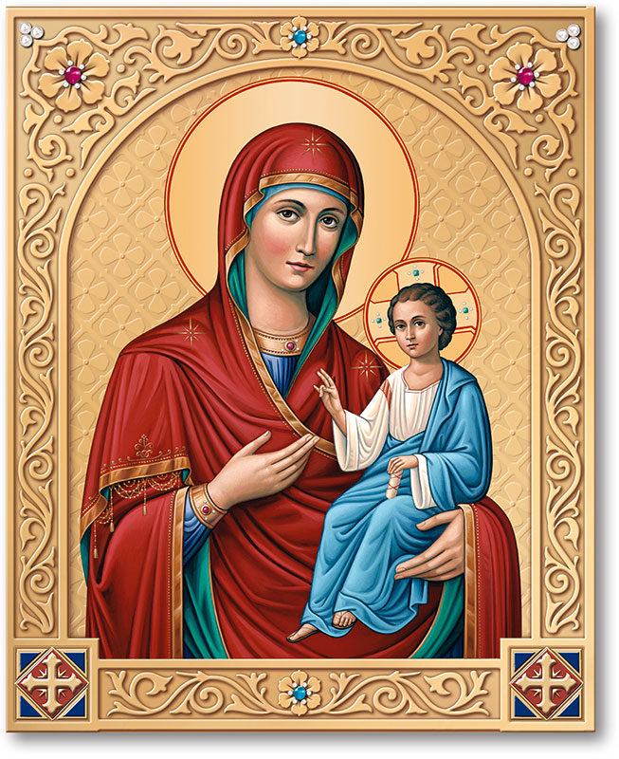
God’s Powerful Word (v34-38)
www.monasteryicons.com

Slide 14
Why bother with Christmas?
Luke 1v26-38
God’s Powerful Word (v34-38)

Slide 15
God’s Powerful Word (v34-38)
Nobody wanted to be famous more than me. I was convinced it was the answer. I was 25, it was the second year of ‘Friends’, and eight months into it, I realized the American dream is not making me happy, not filling the holes in my life… Fame does not do what you think it’s going to do. It was all a trick.
Matthew Perry, Washington Post
Popsugar.com

Slide 16
Why bother with Christmas?
Luke 1v26-38
God’s Powerful Word (v34-38)

Slide 17
Why bother with Christmas?
Luke 1v26-38
God’s Promised King v26-33
God’s Powerful Word (v34-38)

