Slide 1
TRUST and OBEY
God JUDGES and SAVES

Slide 2
The SHADOW

Slide 3
These are a shadow of the things that were to come; the reality, however, is found in Christ.
Colossians 2v17 NIV

Slide 4
For Christ, our Passover lamb, has been sacrificed.
1 Corinthians 5v7b NIV

Slide 5
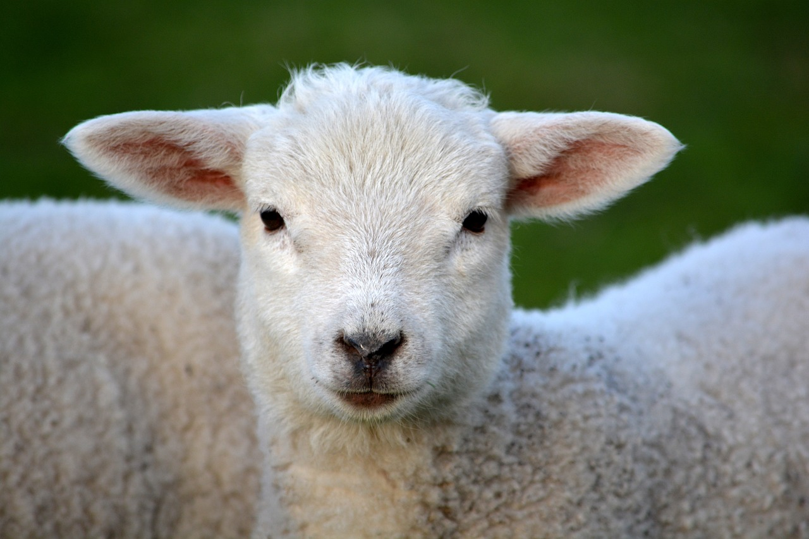
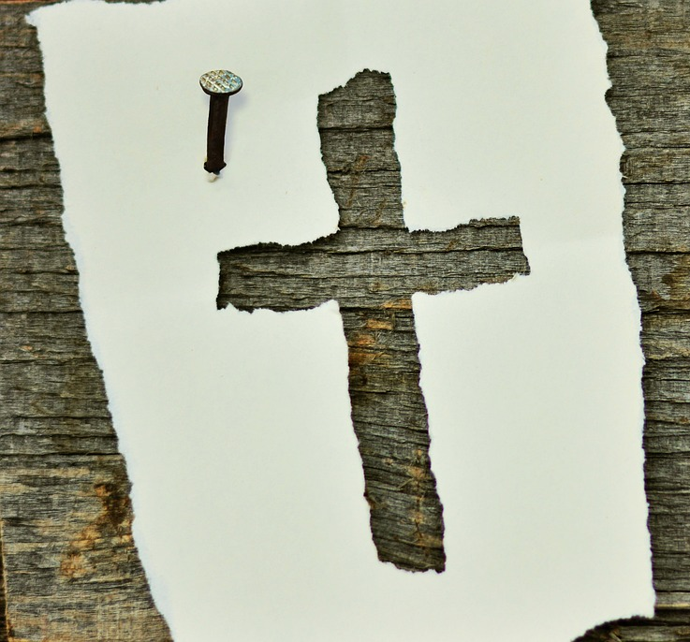
is a SHADOW of

Slide 6
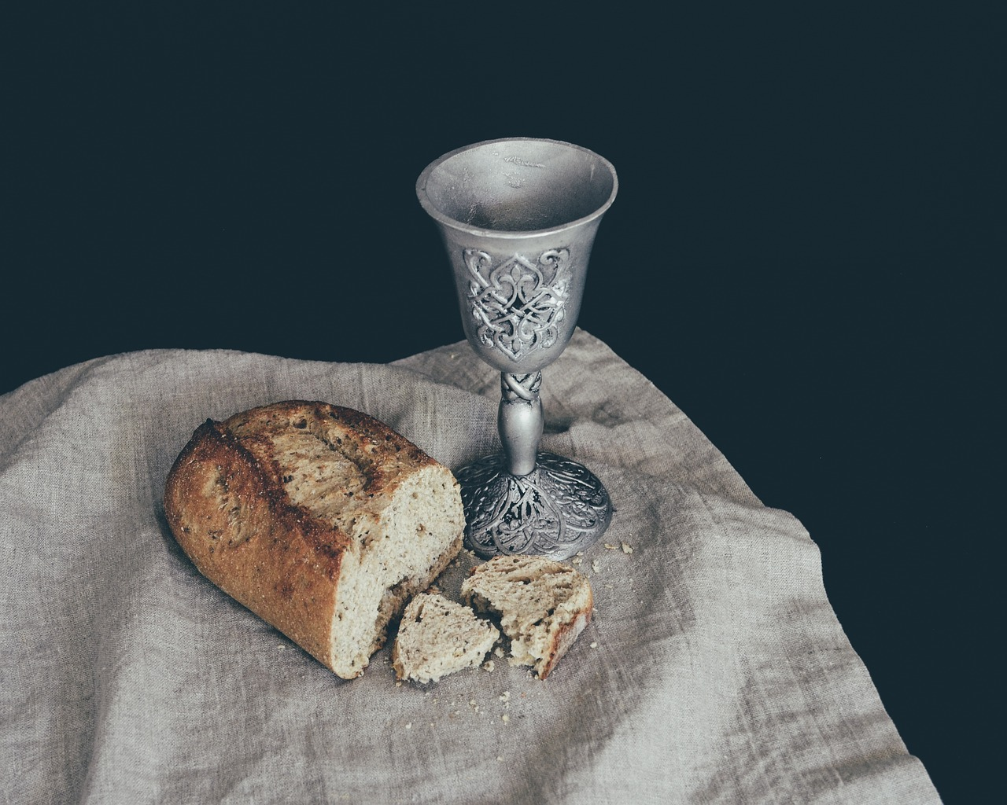

Slide 7
We TRUST and OBEY
God JUDGES and SAVES

