Slide 1
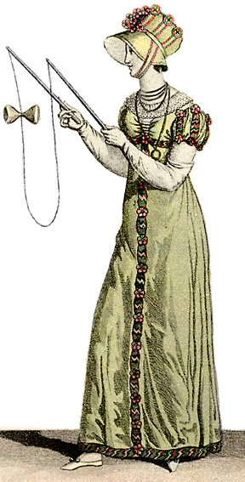
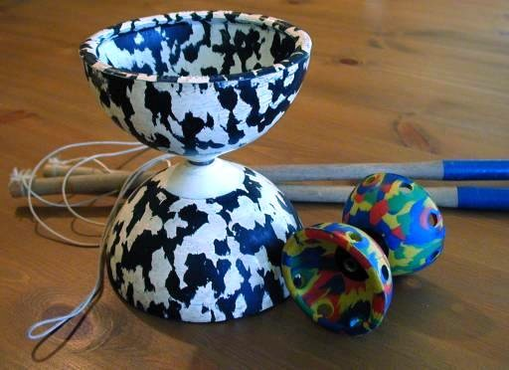
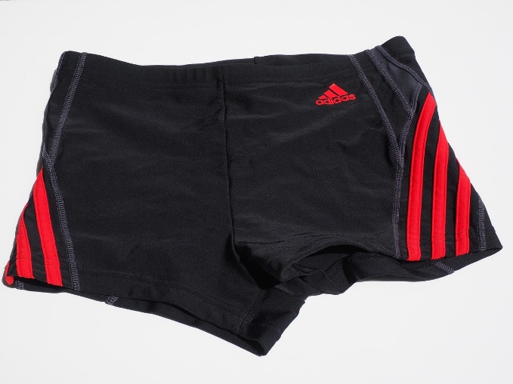
“What did I tell you?!”
EASTER 2024
StoatBringer CC BY-SA 3.0, Wikipedia “diabolo”
Other images c0 Pixabay

Slide 2
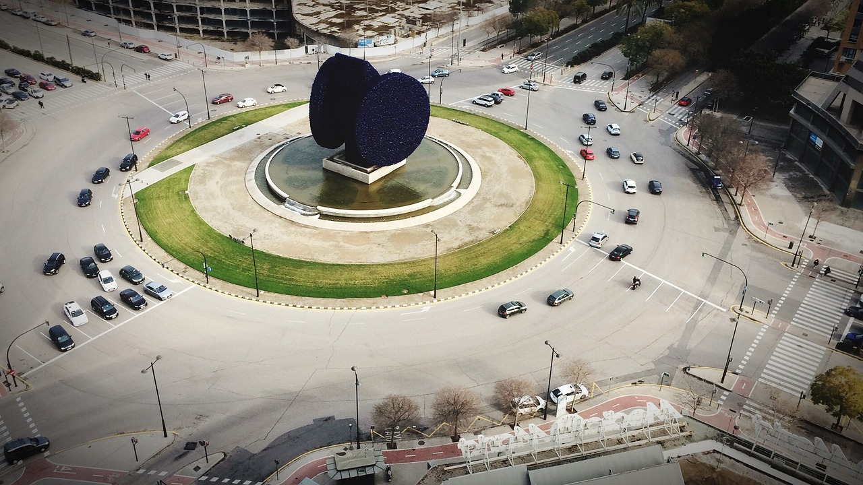
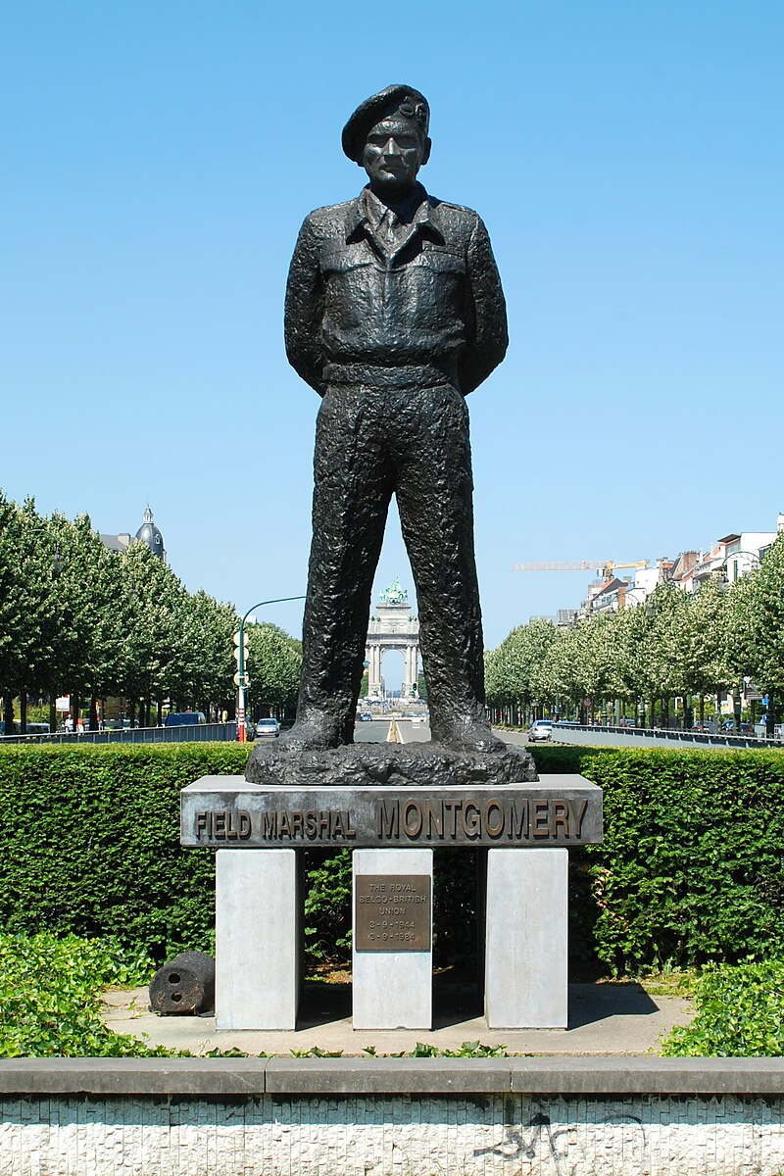
Photo: CCBYSA4.0 EmDEE WIKIPEDIA

Slide 3
“WHAT DID I TELL YOU?!”
Scene 1
confused!
(v13-24)
(v25-31)
(OF THE BIBLE)
Scene 2
CHRIST
Scene 3
CHEERFUL!
(v32-35)
Page 1061
EASTER 2024

